Slide 1



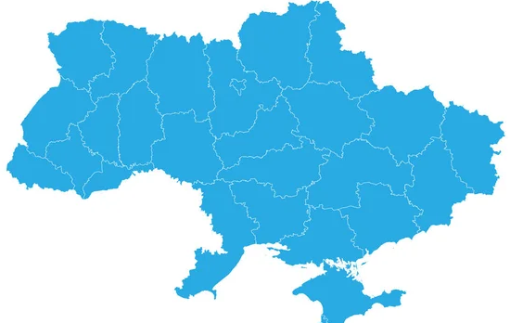

2024
Information digest

Slide 2


2024
This booklet showcases leading Ukrainian enterprises and highlights the business benefits achieved through the implementation of ISO 50001 energy management systems and other energy efficiency measures.
All-Ukrainian Award «Pacesetters for Energy Management» is the FIRST in Ukraine
(is an adapted global Clean award Energy Ministry Energy Management Leadership Awards)
The award is implemented by the European-Ukrainian Energy Agency with the support of the United Nations Industrial Development Organization (UNIDO) Project «Introduction of Energy Management System Standard in Ukrainian Industry», funded by the Global Environment Facility.
Detailed information about the Award is available on the website www.enms-award.com.ua/uk/

Slide 3
2024
ISO 50001
What is ISO 50001?
ISO 50001 is an international energy management system standard that helps businesses implement a systematic approach to improving energy efficiency. It is based on the principle of continuous improvement (PDCA - plan, do, check, improve) and is applicable to any organization, regardless of size or industry.
Why is this important for businesses?
Cost reduction: efficient energy management allows you to reduce energy consumption and reduce energy costs.
Competitiveness: increasing energy efficiency reduces production costs and improves market positions.
Regulatory compliance: helps businesses meet national and international energy and environmental regulations.
Sustainable development: reducing greenhouse gas emissions and environmental impact.
Reputation and investment: ISO 50001 certification increases the trust of partners, customers and investors.
Implementation of ISO 50001 is not just about meeting standards, but also about a strategic approach to efficient resource use that delivers long-term business benefits..

Slide 4
2024
Nominations
Award for Excellence
$ 10 000 for Large enterprises
$ 5 000 for 3 SMEs
To qualify for these awards, companies prepared case studies detailing their experience implementing and certifying ISO 50001/energy efficiency measures.
They shared the business benefits, valuable lessons learned, and key success factors, as well as practical advice for other companies
Award for Initiative
All enterprises that have submitted completed applications in accordance with requirements will be eligible to participate free of charge in 2 UNIDO online trainings on ISO 50001 Energy Management System Implementation and on Energy Efficiency Indicators

Slide 5
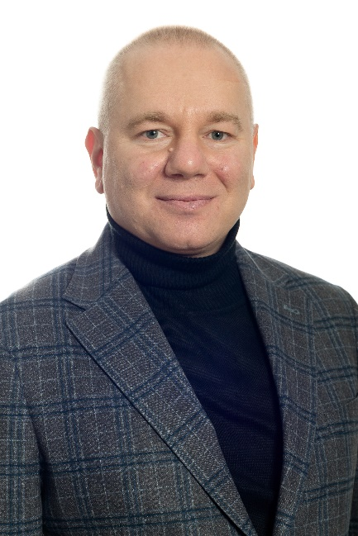
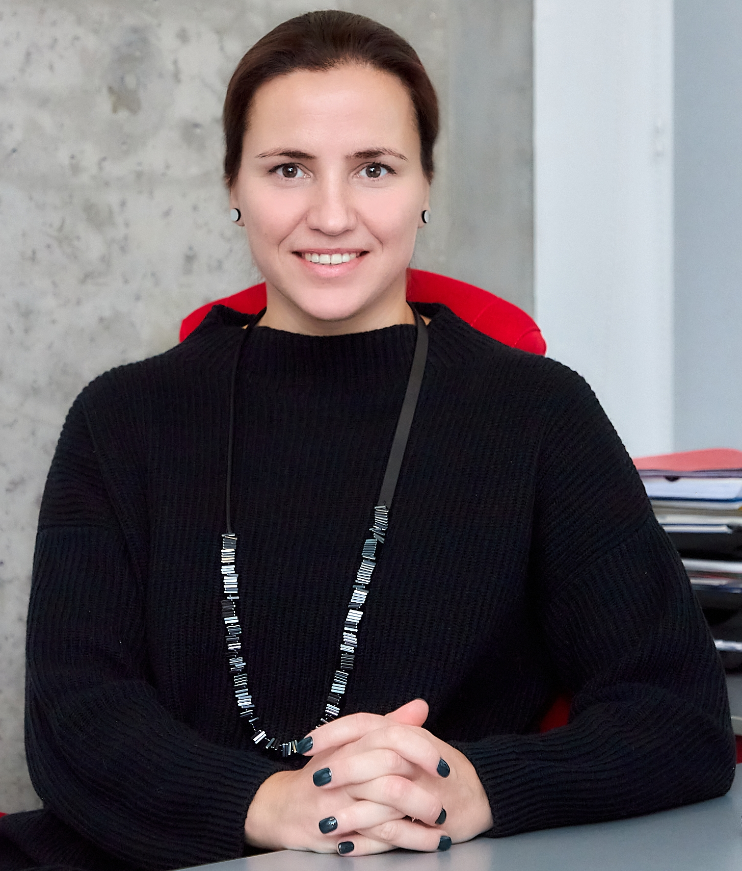
2024
Judges
Olena Rybak,
Executive Director of IC Conculenten Ukraine ,
Deputy Chairwoman of EUEA Board
Anatoliy Chernyavsky,
Candidate of Technical Sciences, Associate Professor of the Department of Power Supply, Institute of Energy Efficiency and Energy Saving

Slide 6
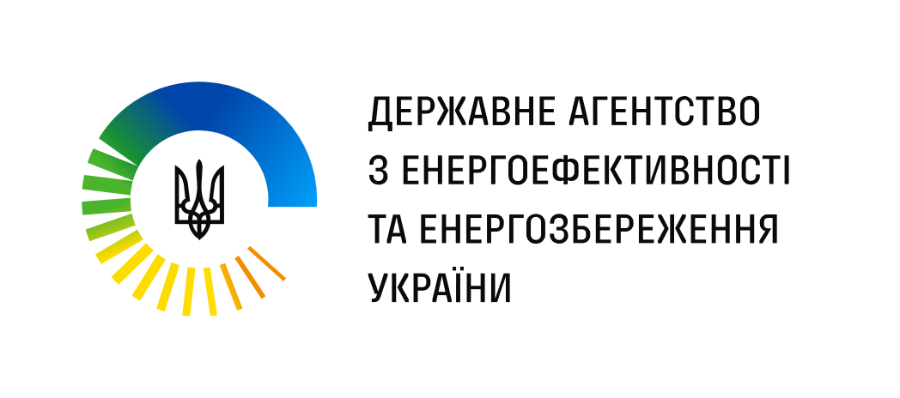


2024
Information partners
State Agency on Energy Efficiency and Energy Saving of Ukraine
The Center for Resource Efficient and Cleaner Production
TMS Ukraine

Slide 7
2024
Participants
Zaporizhkoks, PrJSC
Ukrgrafit, PrJSC
Large enterprises
(a valid ISO 50001 certificate is required)
Agro Kar Ukraine, LLC
Kyivguma, LLC
Kyiv Pasta Factory, LLC
Trivium Packaging Ukraine, LLC
Oberbeton-Invest, LLC
Khorol Mechanical Plant, PrJSC
Uzhgorod Sewing Factory, PrJSC
Pryluky Sewing Factory, PrJSC
8 Paramilitary Mining Rescue Squad
Small/medium enterprises
(achieved significant results in implementing energy efficiency measures/participation in international cooperation programs)

Slide 8












2024
Participants

Slide 9
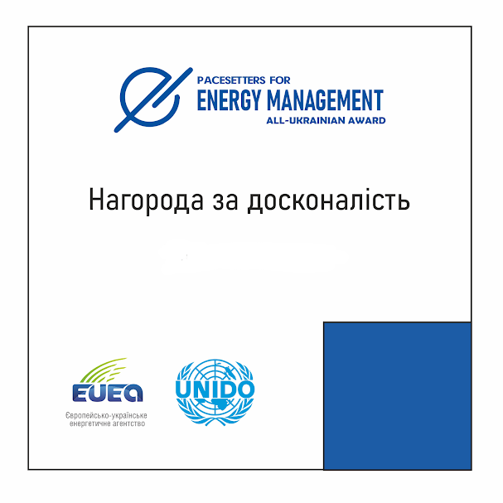
2024
The winners
Ukrgrafit
Kyivguma
Kyiv Pasta Factory
Trivium Packaging Ukraine
Congratulations to the winners of the All-Ukrainian «Pacesetters for Energy Management» Award. The award recognizes leading enterprises that demonstrate energy, economic and environmental benefits obtained by investing in energy efficiency and promote understanding of the need to implement an energy management system (EnMS) according to ISO 50001 standards.

Slide 10
Ukrgrafit is a complex and energy-intensive production with manufacturing technology from initial processing of raw materials to packaging of finished products. Consumers of Ukrgrafit products are metallurgical enterprises in Ukraine and more than 30 countries of the world.
In 2013, the founders and top management of Ukrgrafit decided to implement SEnM at the enterprise. In 2017, the enterprise was certified in accordance with the requirements of the international standard ISO 50001.
Since the SEnM certification, the enterprise has implemented modern solutions aimed at saving energy resources and reducing their consumption during product production:
modernization of the graphitization process — installation of new energy-efficient longitudinal graphitization furnaces;
modernization of the mechanical processing process of carbon-graphite products;
modernization of the firing process — new gas furnaces with a thermal afterburning system with heat recovery and complex industrial equipment for the air purification system from firing furnaces using the technology of regenerative thermal oxidation of volatile organic compounds were installed;
compressor station modernization, etc.
Thanks to the energy management system and such measures, energy saving amounted to 214.6 GWh, cost savings amounted to UAH 330 million, and CO2 emissions were reduced by 593,800 tons.
2024

Slide 11
Kyivguma is a medium – size enterprise with a long history, occupying one of the leading positions in the Ukrainian market of rubber, latex, silicone, PVC, TEP and plastic products for all sectors of industry and the national economy.
Kyivguma’s products are supplied to all regions of Ukraine and over 30 countries around the world. The enterprise faced the challenges of energy instability, in particular due to blackouts, which became the impetus for the installation of a solar power plant with a generation capacity of 671 kW. At the same time, the enterprise implemented the following measures:
equipping steam fittings with heat-insulating covers;
reconstruction of thermal insulation of steam pipelines;
automation of drying machines for drying dielectric gloves;
fingertip production plant.
As a result of all these measures, energy savings amounted to 1,713 MWh, cost savings amounted to UAH 9.8 million, and CO2 emissions were reduced by 665.8 tons.
2024

Slide 12
Kyiv Pasta Factory is a medium – size enterprise with over a century of history and one of the most powerful production facilities in Ukraine, which annually produces over 10,000 tons of pasta.
After the energy audit, the following measures were taken:
reconstruction of the heating and hot water supply system;
installation of a heat recovery unit from exhaust air;
thermal modernization of buildings;
compressed air system optimization;
replacing the burner in a gas boiler;
modernization of the lighting system.
Thanks to such measures, energy savings amounted to 436 MWh, cost savings amounted to UAH 1.1 million, and CO2 emissions were reduced by 110.2 tons.
2024

Slide 13
Trivium Packaging Ukraine in Bila Tserkva is a medium – size enterprise part of the international company Trivium Packaging, which is one of the world’s leading manufacturers of tin containers for food, aerosol and household chemicals and is the leader in the Ukrainian market for the production of three-piece metal cans for food products. In 2022, a decision was made to implement an energy management system in order to continuously improve energy efficiency indicators.
The energy efficiency goals set within the framework of the SEnM were achieved by implementing measures to optimize energy consumption, modernize equipment with mandatory consideration of projects to reduce negative environmental impact. First of all, this concerns waste heat utilization projects:
utilization of waste heat from air compressors for water heating;
using excess heat from another compressor for heating production facilities;
construction and commissioning of a solar power plant on the roof of a production building;
replacement of the lighting system of production and office premises with LED lamps;
replacing the welding machine with a more energy-efficient one.
The implementation of all these measures contributed to energy savings of 3,500 MWh, cost savings amounted to UAH 5.0 million, and CO2 emissions were reduced by 795.5 tons.
2024

Slide 14
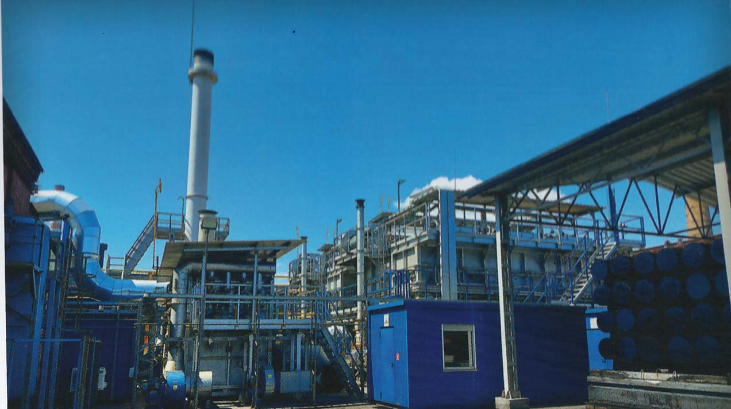
2024
Manufacture of other electrical equipment,
Ukraine, Zaporizhzhia
Ukrgrafit, PrJSC
ISO 50001 certified
Savings - UAH 330 million over 7 years
Reduction of CO2 emissions - 593 802.2 tons

Slide 15
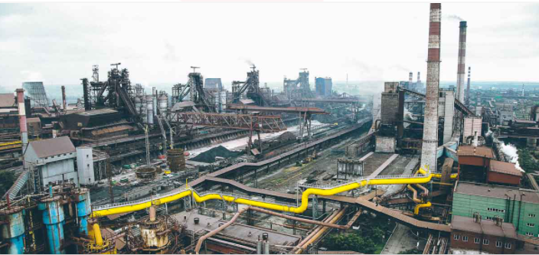
2024
Coal coke and coke-chemical products,
Ukraine, Zaporizhzhia
Zaporizhkoks, PrJSC
ISO 50001 certified
Savings— UAH 543,536,457 over 10 years
Reduction of CO2 emissions— 92,343 tons

Slide 16
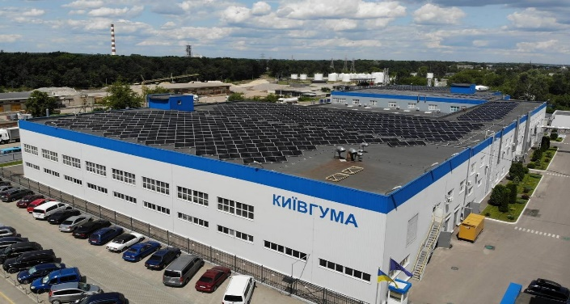
2024
Production of rubber products Ukraine, Brovary
Kyivguma, LLC
Participated in EU4Environment Programme
Savings— UAH 9,832.0 thousand for 4 years
Reduction of CO2 emissions— 665.8 tons

Slide 17
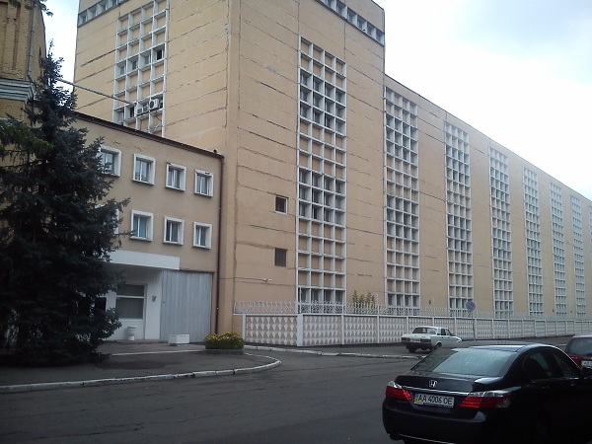
2024
Food production
Ukraine, Kyiv
Kyiv Pasta Factory, LLC
Participated in EU4Environment Programme
Savings— UAH 1,184,465 per year
Reduction of CO2 emissions — 110.2 tons

Slide 18
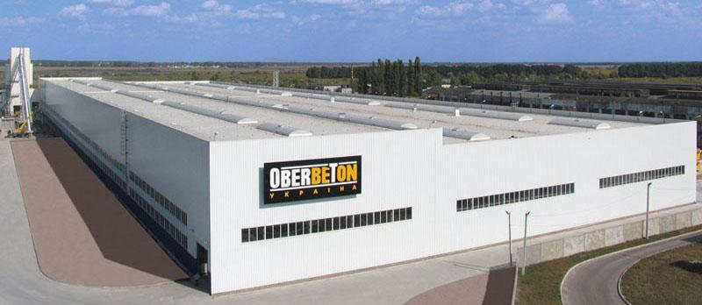
2024
Production of building materials
Ukraine, Zhytomyr
Oberbeton-Invest, LLC
Participated in EU4Environment Programme and
GIZ project «Consulting enterprises on energy efficiency»
Savings— UAH 6,029,504 over 5 years
Reduction of CO2 emissions— 340 tons

Slide 19
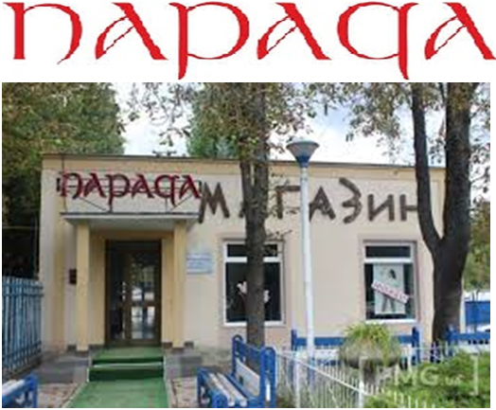
2024
Outerwear production
Ukraine, Uzhgorod
Uzhgorod Sewing Factory, PrJSC
Participated in EU4Environment Programme
Savings— UAH 1,565,042 in 1.5 years
Reduction of CO2 emissions — 102.3 tons

Slide 20
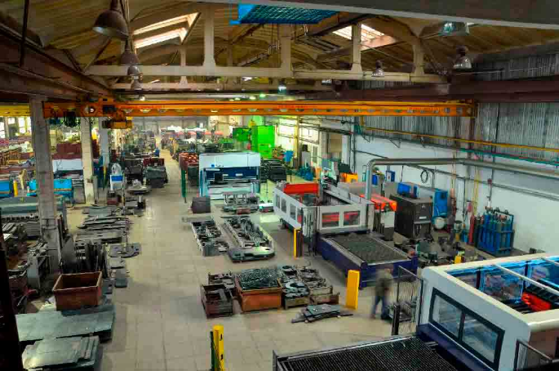
2024
Production of agricultural machinery and equipment
Ukraine, Khorol
Khorol Mechanical Plant, PrJSC
Participated in EU4Environment Programme and
GIZ project «Consulting enterprises on energy efficiency»
Savings— UAH 2,576,995 over 5 years
Reduction of CO2 emissions— 501 tons

Slide 21
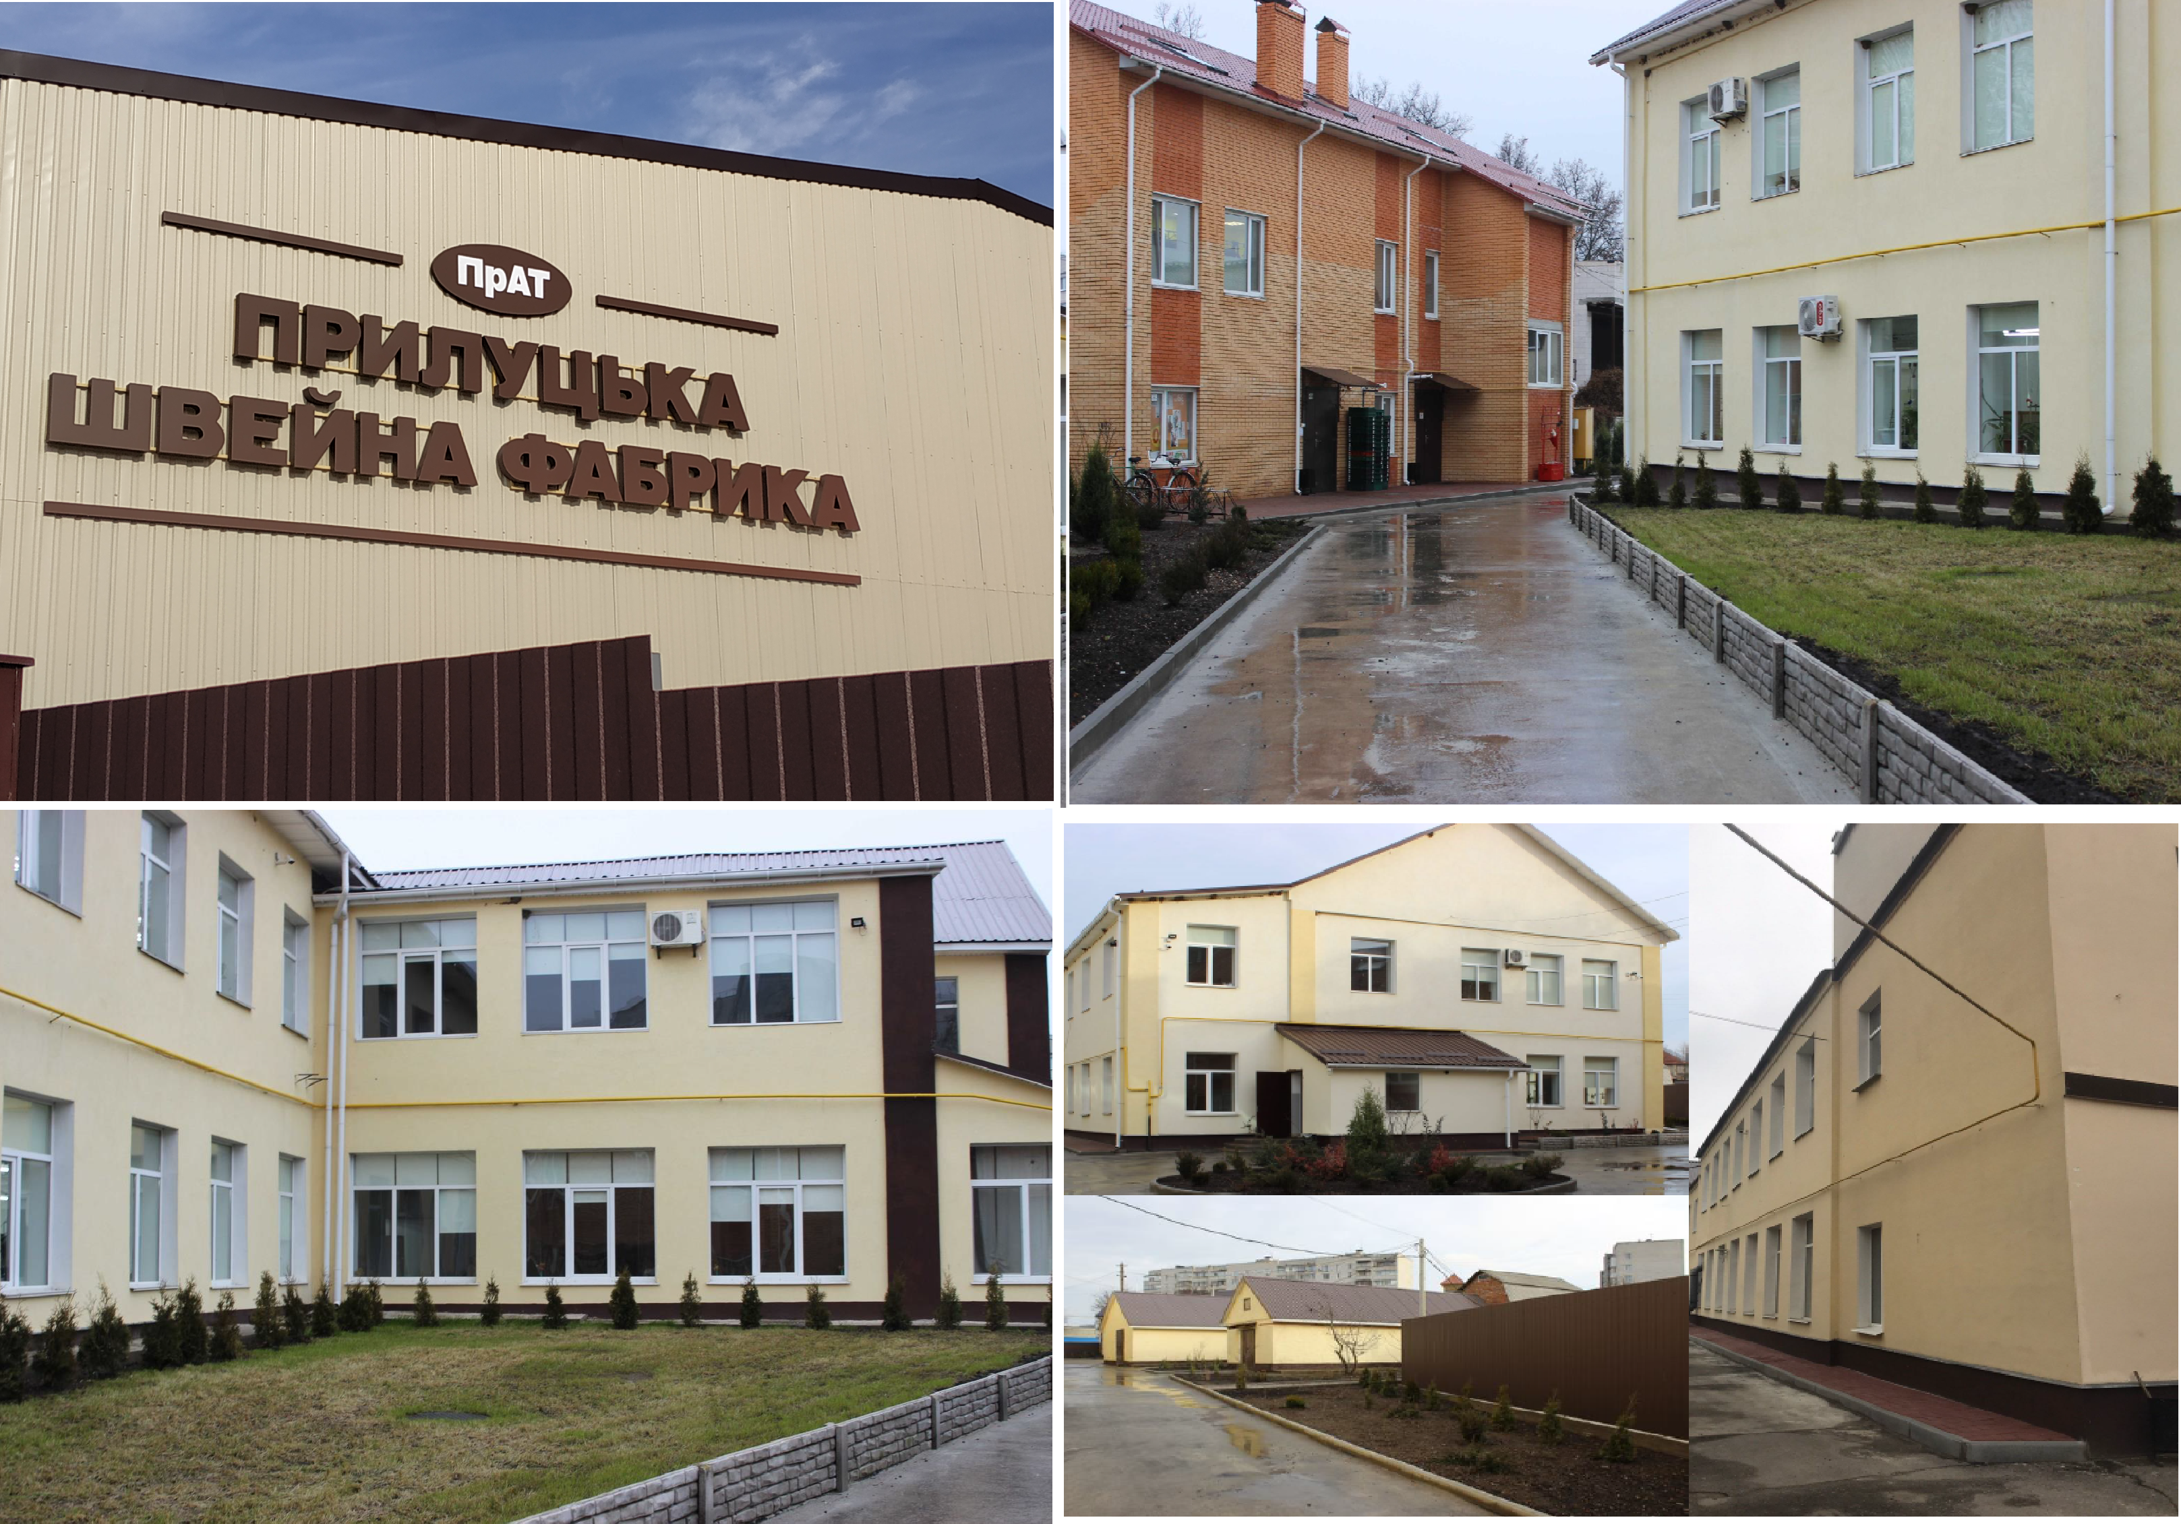
2024
Outerwear production
Ukraine, Pryluky
Pryluky Sewing Factory, PrJSC
Participated in Canada-Ukraine Trade and Investment Support Project and UNIDO Resource – Efficient and Cleaner Production Project
Savings— UAH 4,376,956 over 5 years
Reduction of CO2 emissions— 300 tons

Slide 22
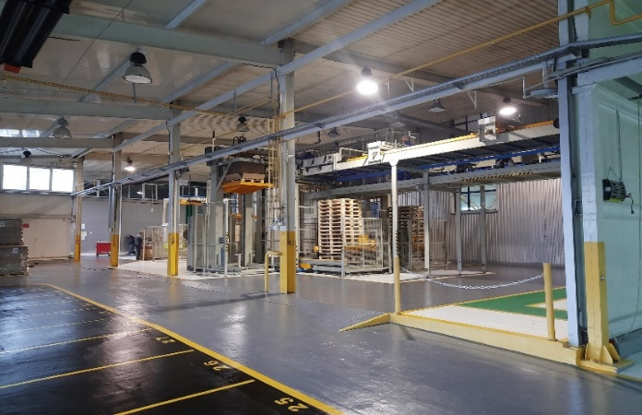
2024
Production of lightweight metal packaging materials
Ukraine, Bila Tserkva
Trivium Packaging Ukraine, LLC
Participated in UNIDO Industrial Capacity Building, Policy and Diagnostics for Ukraine’s Green Recovery Project
Savings— UAH 5 million over 4 years
Reduction of CO2 emissions— 795.5 tons

Slide 23
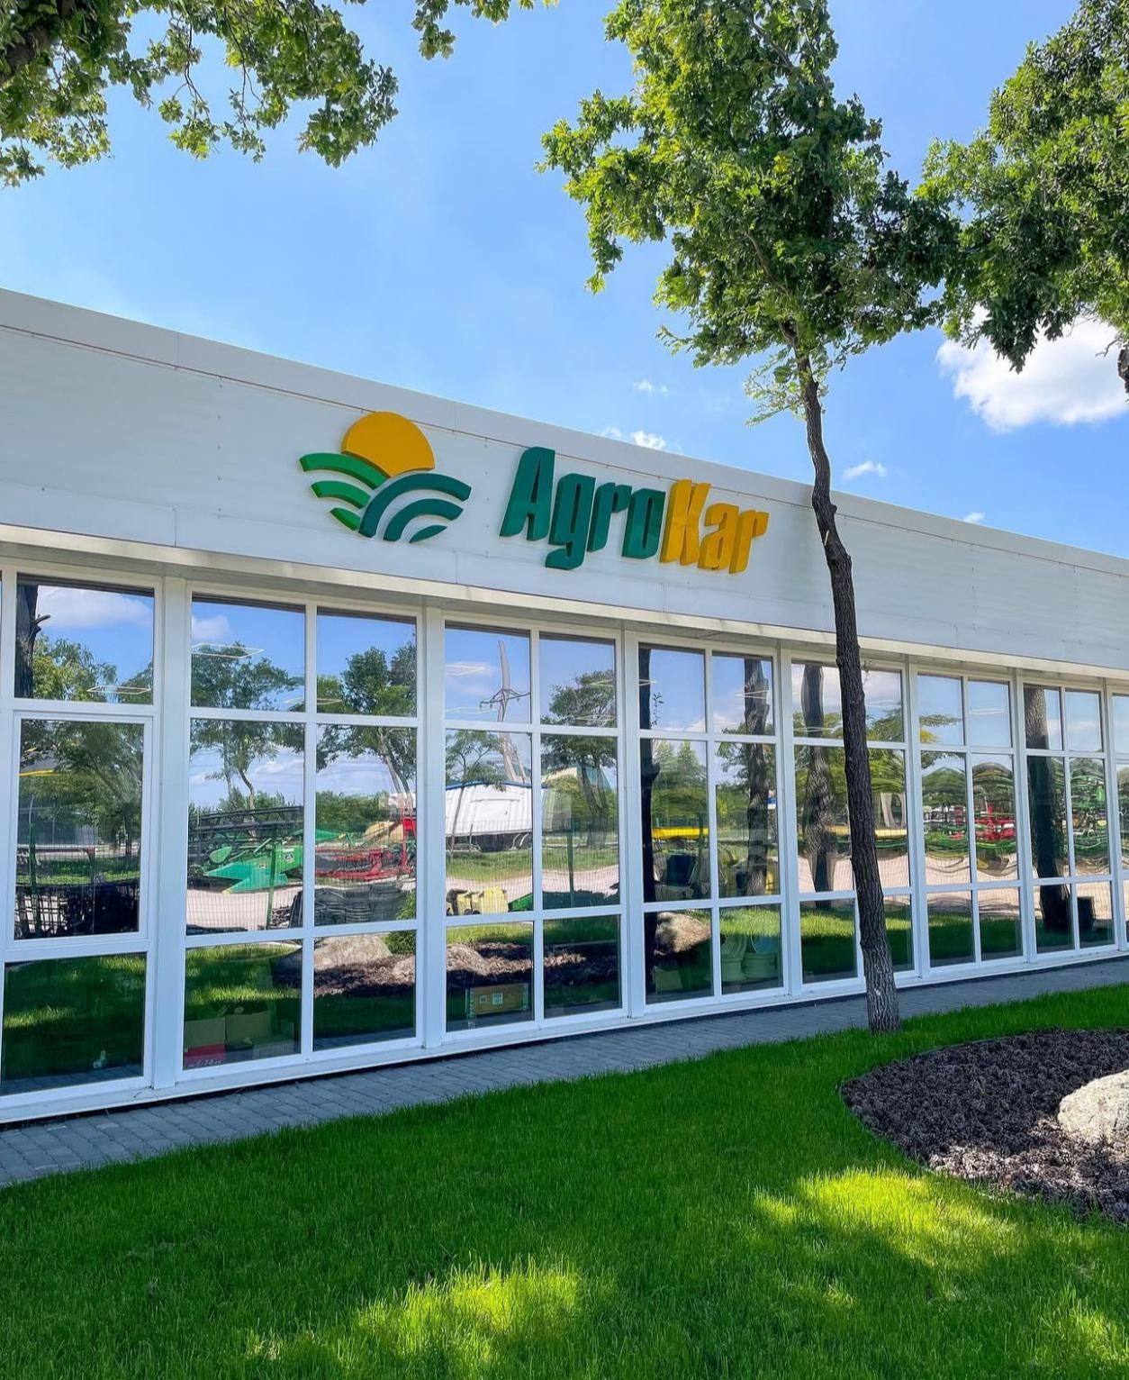
2024
Engineering
Ukraine, Kropyvnytskyi
Agro Kar Ukraine, LLC
Self-started Energy Efficiency programme
Savings— UAH 609.0 thousand per year
Reduction of CO2 emissions — 42.5 tons

Slide 24
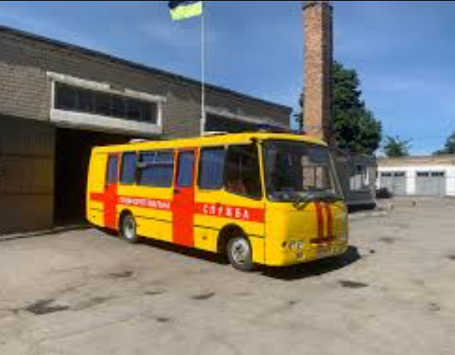
2024
Ministry of Energy of Ukraine.
Emergency and rescue operations.
Ukraine, Pavlograd
8 Paramilitary Mining Rescue Squad
Self-started Energy Efficiency programme
Savings — UAH 45.0 thousand per year
Reduction of CO2 emissions — 2.25 tons

Slide 25

2024
Participating cities
Pryluky
Brovary
Київ
Zhytomyr
Kyiv
Khorol
Bila Tserkva
Uzhhorod
Pavlohrad
Kropyvnytskyi
Zaporizhzhia

Slide 26
More information
Website: euea-energyagency.org/uk/pacesetter-award/
Facebook page: facebook.com/AwardEnMS
E-mail: enms@euea-energyagency.org

